Slide 1
Undergraduate
Research
By: Jennifer Chiang
Notes:
15-20 minutes, 15 minutes for presentation 5 min for q&a

Slide 2

The problem

Slide 3
Exploring Speeded Up Robust Features (SURF) Based Algorithms for Large and Dynamic Image Retrieval

Slide 4
Concepts leveraged
Computer vision
What is image processing
How image processing works
How are similar objects detected
High performance computing
Environment that tests were run in
Anytime algorithms
Real time retrieval solution
Parallel/distributed processing
Speed up the algorithm and run more portions with anytime design in mind

Slide 5
Project based problem
Relevancy
Cannot wait for an infinite database to finish processing
Social media platforms are constantly being updated
No clearly identified solution to the question
Question
Is there a better solution to real time retrieval of images from large and dynamic databases?

Slide 6
Different concepts and how they’re used in the project

Slide 7
Computer vision
Images from a computer’s point of view
What is image processing
How image processing works to detect objects
Image processing algorithms for object detection
SIFT
Scale Invariant Feature Transform
SURF
Speeded Up Robust Features

Slide 8
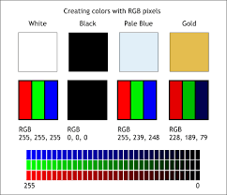
Images/Photos
Image on a laptop not interpreted in the same way as our naked eye
Digital image
Computer representation of an image
Different forms images can be represented
Matrices
Bits
Pixels
Made up of pixels
Each pixel represents a color
What exactly does an image look like as a wavelength?

Slide 9
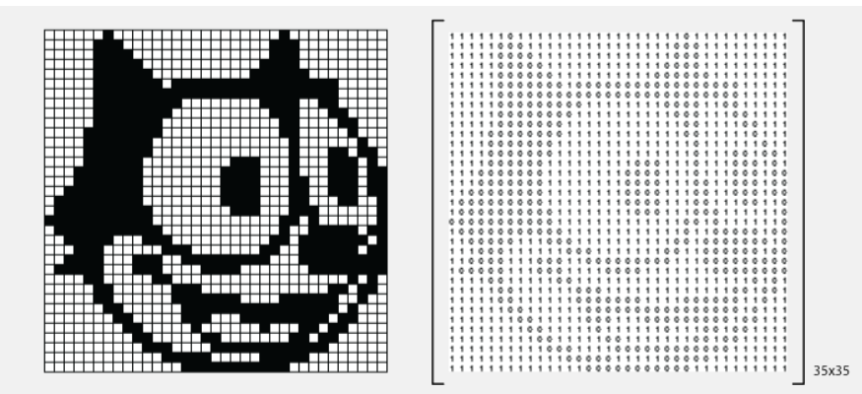

Slide 10
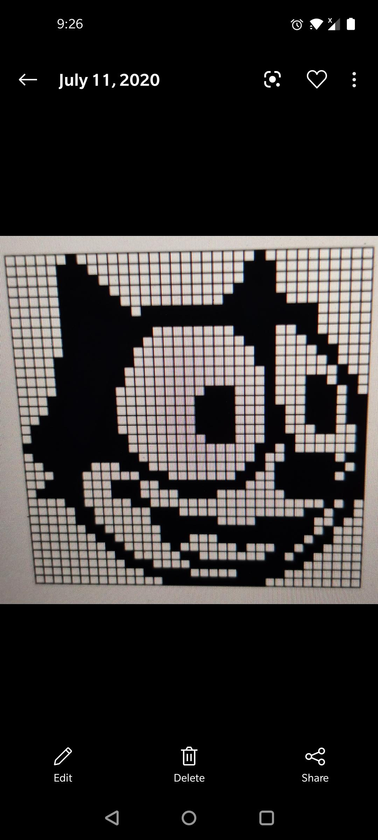
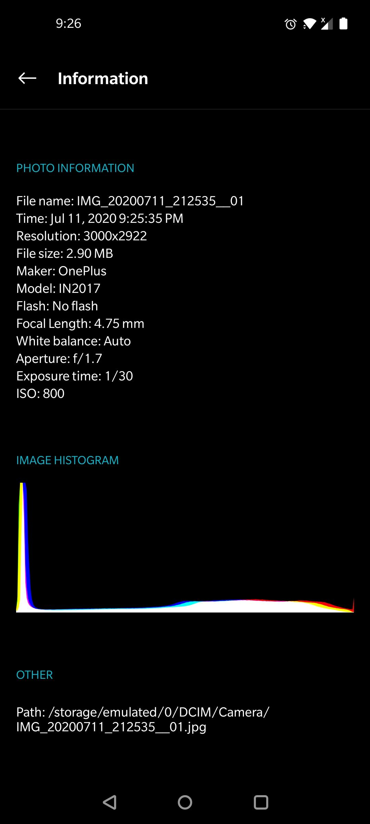

Slide 11
Image processing
“Image processing is a method to perform some operations on an image, in order to get an enhanced image or to extract some useful information from it. ” (Digital Image Processing - University of Tartu)
Part of bigger field known as computer vision, frequently used in AI
(Fundamentals of Image Processing - University of Technology)

Slide 12
How to detect similarities from images/videos
Remove noise
Done with filters
Feature detector
How are key features found?
Feature descriptor
What describes this key feature and is unique to only this feature?
Color
Angle
Position
Find keypoints & orientation assignment

Slide 13
Image processing algorithms: SIFT & SURF
SIFT - Scale Invariant Feature Transform
Led to a mini-revolution in computer vision
SURF - Speeded Up Robust Features
Improved on SIFT
Both scale and rotation invariant
*U-SIFT & U-SURF exist, this is the nonrotation invariant version of the algorithms
Both algorithms are patented, but available for research and academic use

Slide 14
Speeded Up Robust Features (SURF)
Speed
Improved SIFT with better computation time
Fast-Hessian Detector
Determinant of hessian matrix used for selecting keypoint location and orientation
Evaluated independent of matrix size
Box filters and integral images
Does not need to iteratively apply filters
Filters can be applied directly and even run in parallel
Low computational cost
Robustness
Possible parallelization to be explored
Notes:
Put in high level figure of SURF here and you can talk about each of the sections more easily

Slide 15
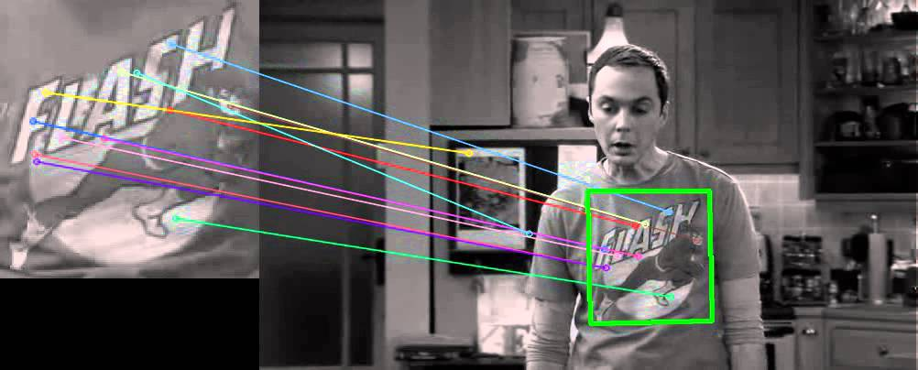

Slide 16
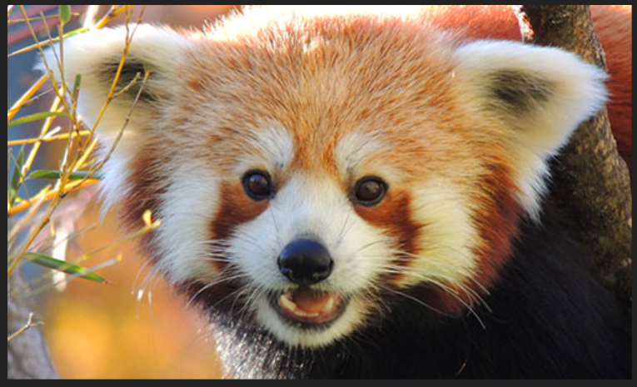

Slide 17
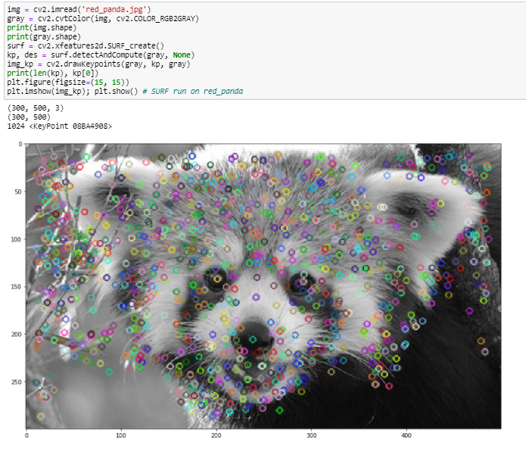

Slide 18
Anytime Algorithms

Slide 19
Definition
Algorithm that improves its results the longer it runs, and can return a valid solution even if it is interrupted

Slide 20
Purpose
Guarantee a solution even if it is interrupted
Provide a solution to large datasets
Typically used in real time systems
Where users may the the solution within a time constraint
Notes:
Make sure you talk about the properties of anytime design
Not all algorithms will be able to be made into an anytime design, criterias for anytime design, how our initial anytime design is anytime design

Slide 21
Properties of anytime design
Be an algorithm
Guaranteed to terminate at some point
Provide an approximate solution even when stopped
Stoppable at any time
Improving answer the longer it runs
Uniformly and continuously better the approximate solution the longer it runs

Slide 22
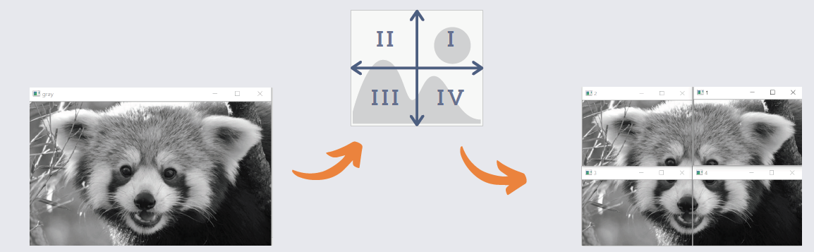
Initial anytime algorithm design

Slide 23
Experimental Methodology
Test environment
Jupyter notebook on local machine for initial development
Hpc server for testing and later development
Data preprocessing
Dimension conversion
Color conversion
Tests performed
Number of keypoints test
Euclidean distance test
Number of perfectly matched keypoints

Slide 24
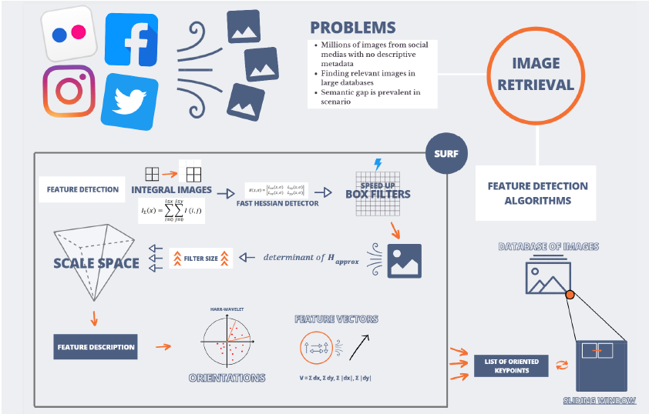

Slide 25
Results gathered

Slide 26
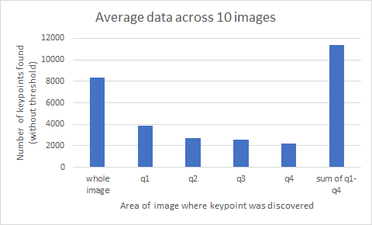
Number of keypoints found

Slide 27
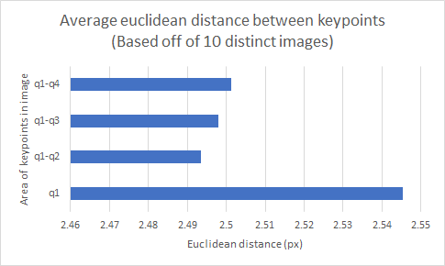
Euclidean Distance between Keypoints

Slide 28
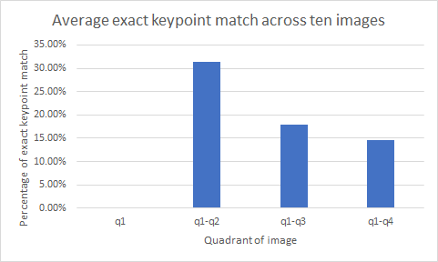
Perfectly matched keypoints

Slide 29
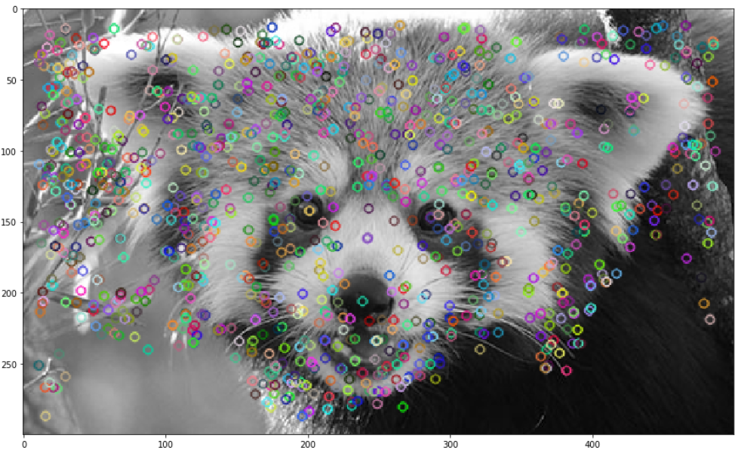
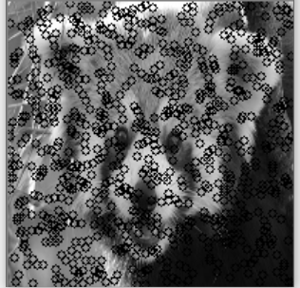
Notes:
Show the test ran on multiple images with the keypoints circled in the report put 5 images, in the presentation put 2 images of the opencv version and the one ran with my algorithm for comparison

Slide 30
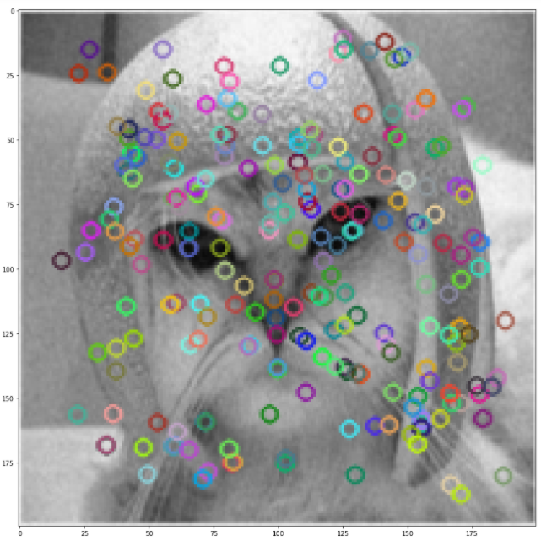
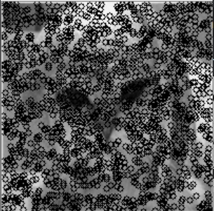

Slide 31
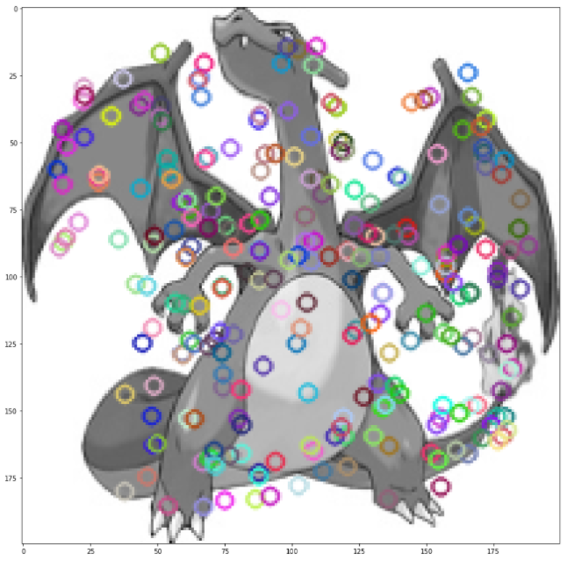
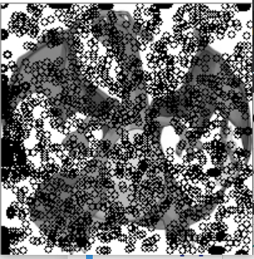

Slide 32
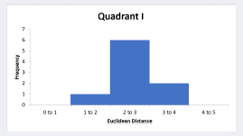
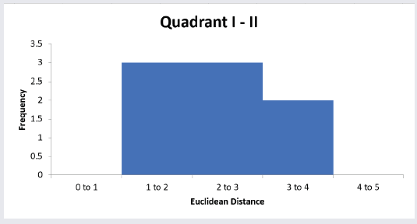
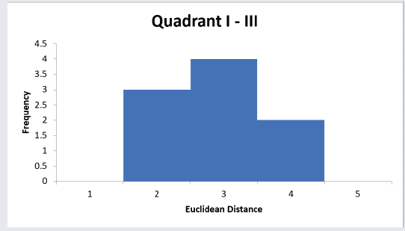
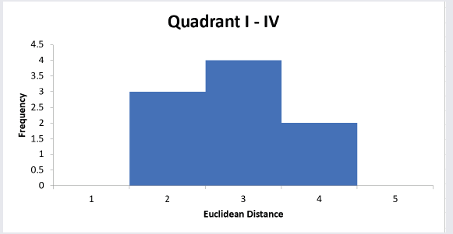
Euclidean Distance Results

Slide 33
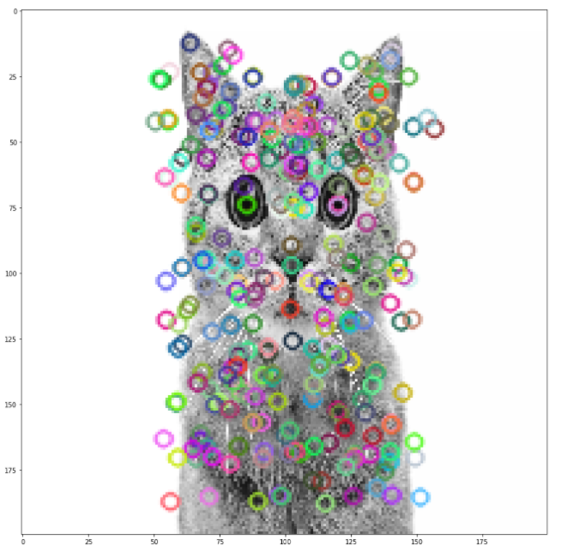
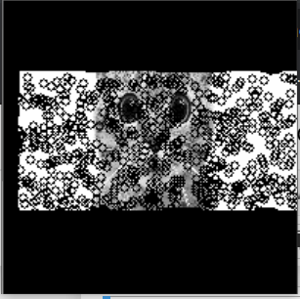
Problems encountered

Slide 34
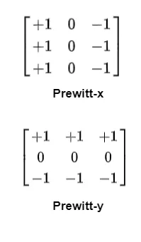
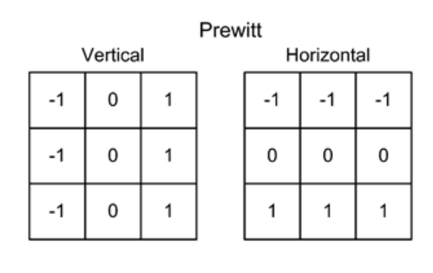
Conflicting results

Slide 35
Conclusion and Future Work
Tests did not conform to expected result
Expected monotonically nondecreasing trend
Additional testing to see why tests did not conform to expected trend
Parallelization to be implemented
Sliding windows added to code
Additional tests to be performed to calculate sliding window overhead

